Slide 1


Slide 2
Online Examination System
LU Exam Hive

Slide 3
Designed & Crafted By:
Mohammed Saduzzaman Sadi
Mohi Uddin Pabel
Toufique Ahmad

Slide 4


An online examination system is a computer-based test system that can be used to conduct computer based tests online. This examination system uses fewer resources and reduces the need for question papers and answer scripts, exam room scheduling, arranging invigilators, coordinating with examiners, and more.

Slide 5

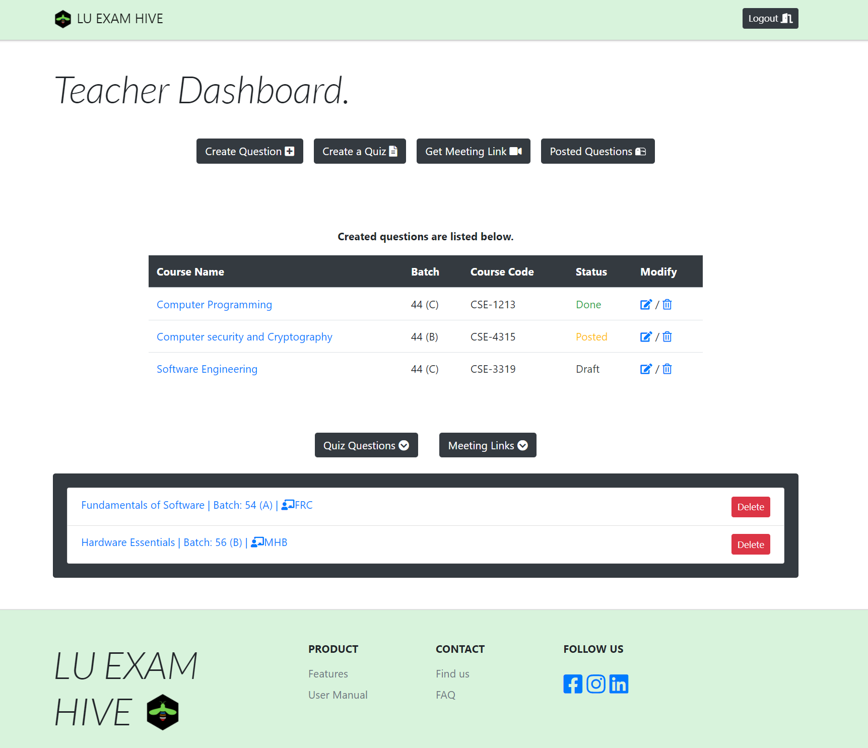


Widely Used
Integrated
LU Exam Hive

Slide 6



Audience
Teacher
No More:
Complex
UI
Student
We Prefer:
Effortless
UI
Admin

Slide 7

Vision
“Reach the heights”
LU Exam Hive

Slide 8
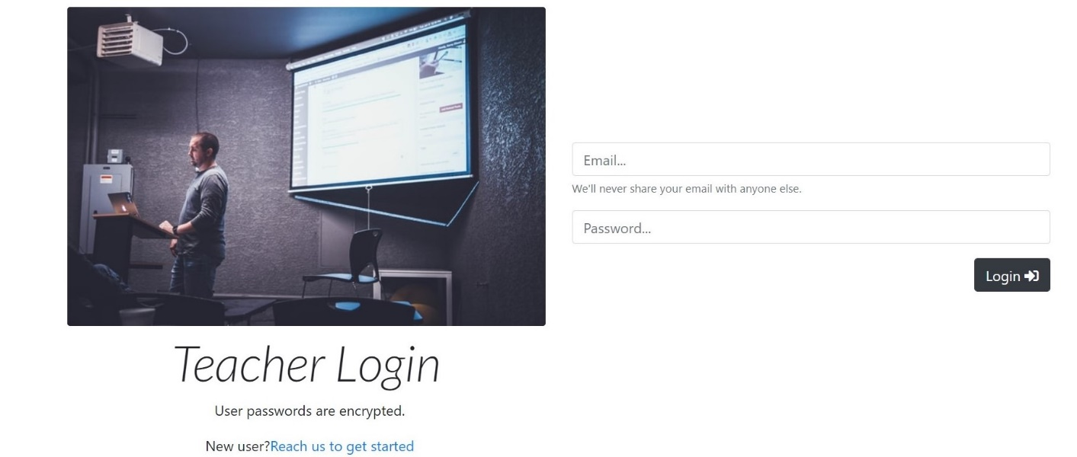
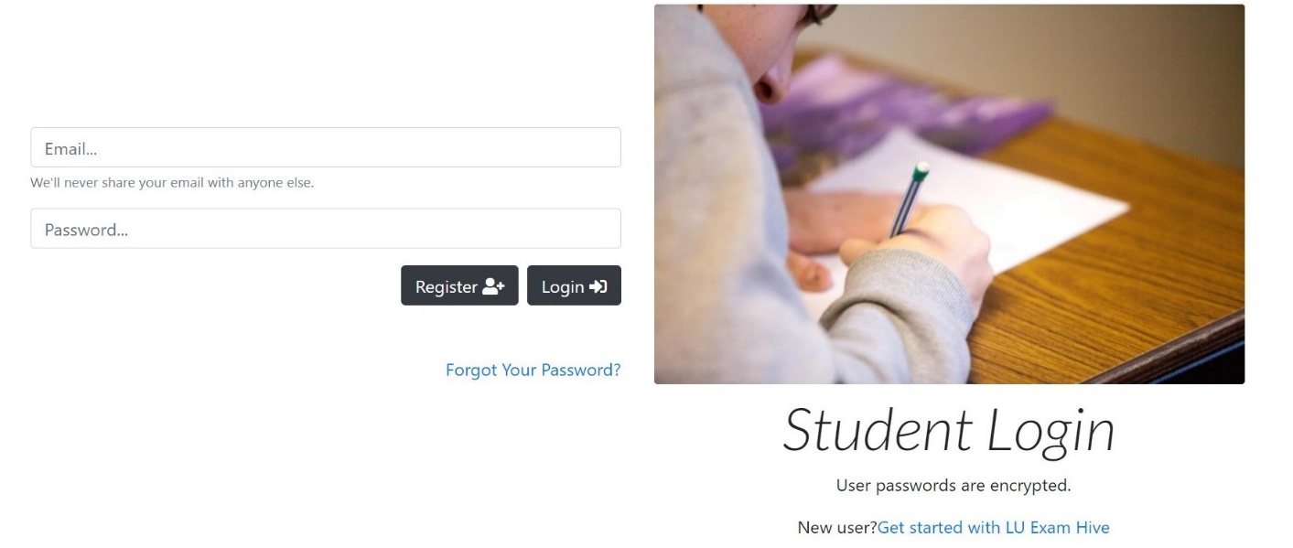
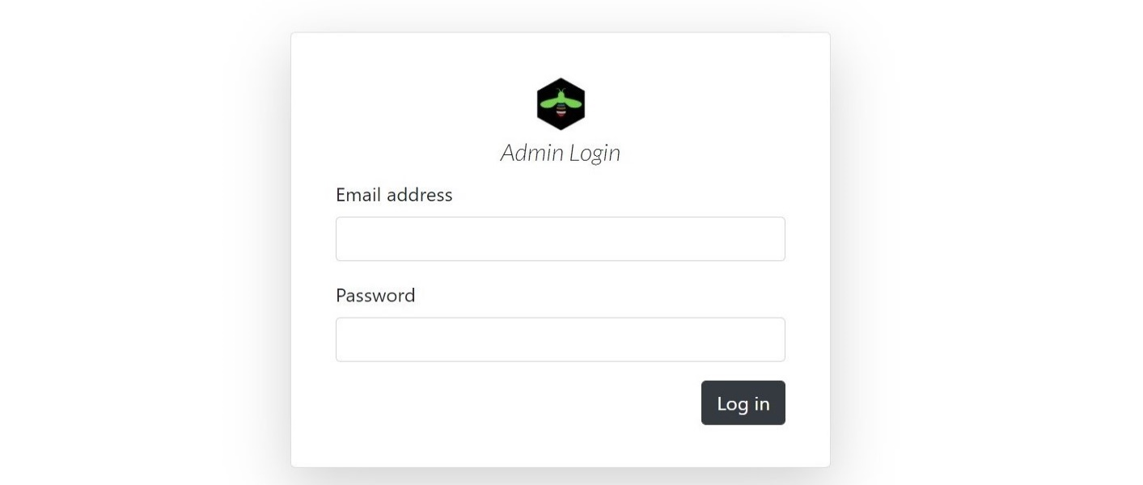
Avatars
Teacher Avatar
Student Avatar
Admin Avatar

Slide 9


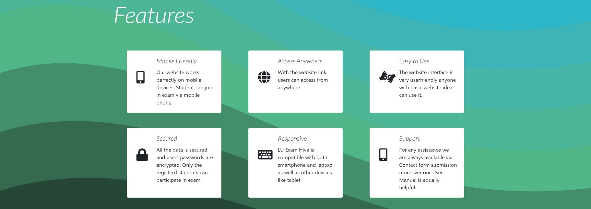
SVG
SVG stands for Scalable Vector Graphics. It is used to define vector-based graphics for the Web. Every element and every attribute in SVG files can be animated.

Slide 10



Mailer
PHPMailer is a code library to send emails safely and easily via PHP code from a web server.
Validates email addresses automatically
Protects against header injection attacks
Error messages in over 50 languages
Compatible with PHP 5.5 and later
Namespaced to prevent name clashes
Integrated SMTP support

Slide 11


request_reset_password.php
student_Registration.php
contact.php

Slide 12
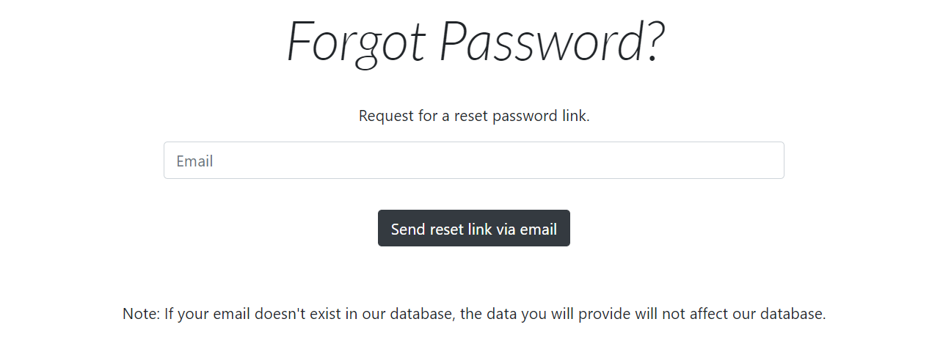
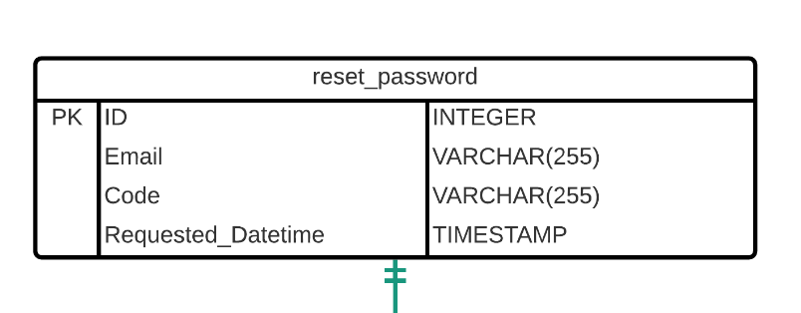
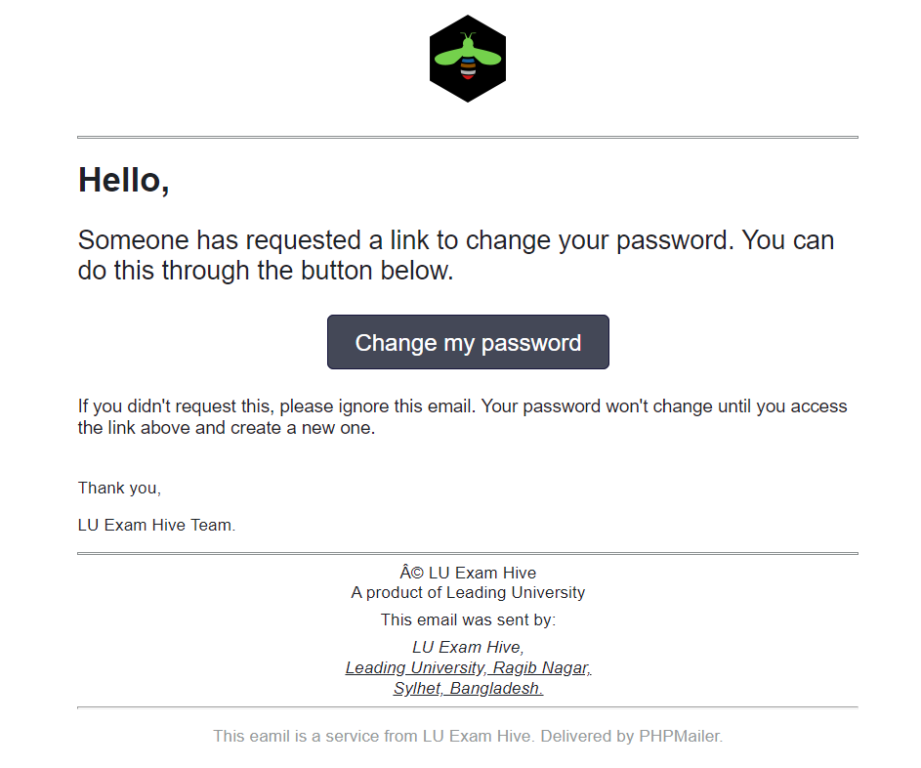
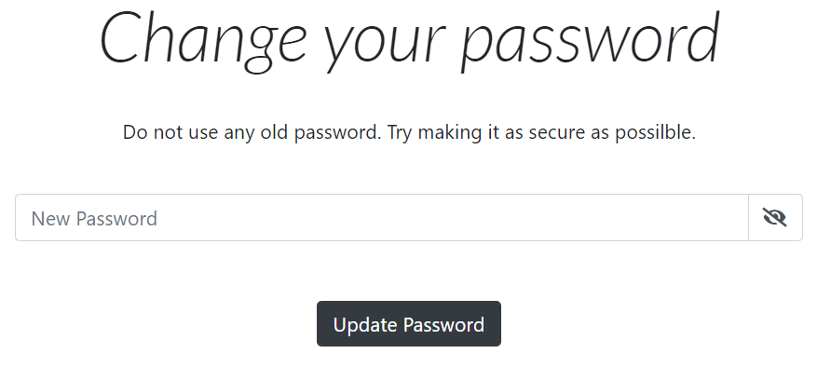
Did you forget your password again??

Slide 13
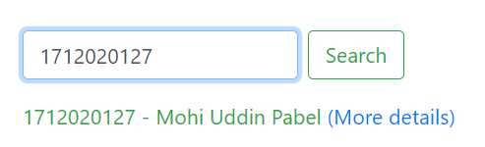
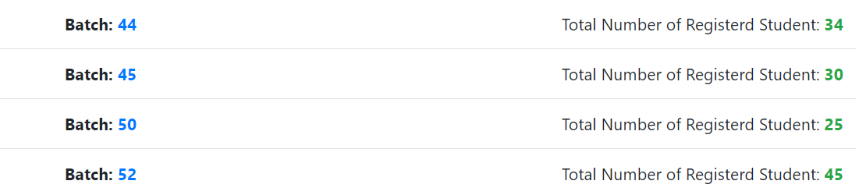
Effective Search
if (isset($_POST["search"])) {
$id = $_POST["id_to_search"];
$sql = $pdo->prepare("SELECT * FROM `Student` WHERE Student_ID = '$id'");
$sql->setFetchMode(PDO::FETCH_OBJ);
$sql->execute();
if ($row = $sql->fetch()) {?>
<p class="mt-3 text-success">
<?php echo $row->Student_ID . ' - ' . $row->FirstName . ' ' . $row->LastName . ' '; ?>
<a href="admin_student_details.php?id=<?php echo $row->Student_ID; ?>"> (More details)</a>
</p>

Slide 14
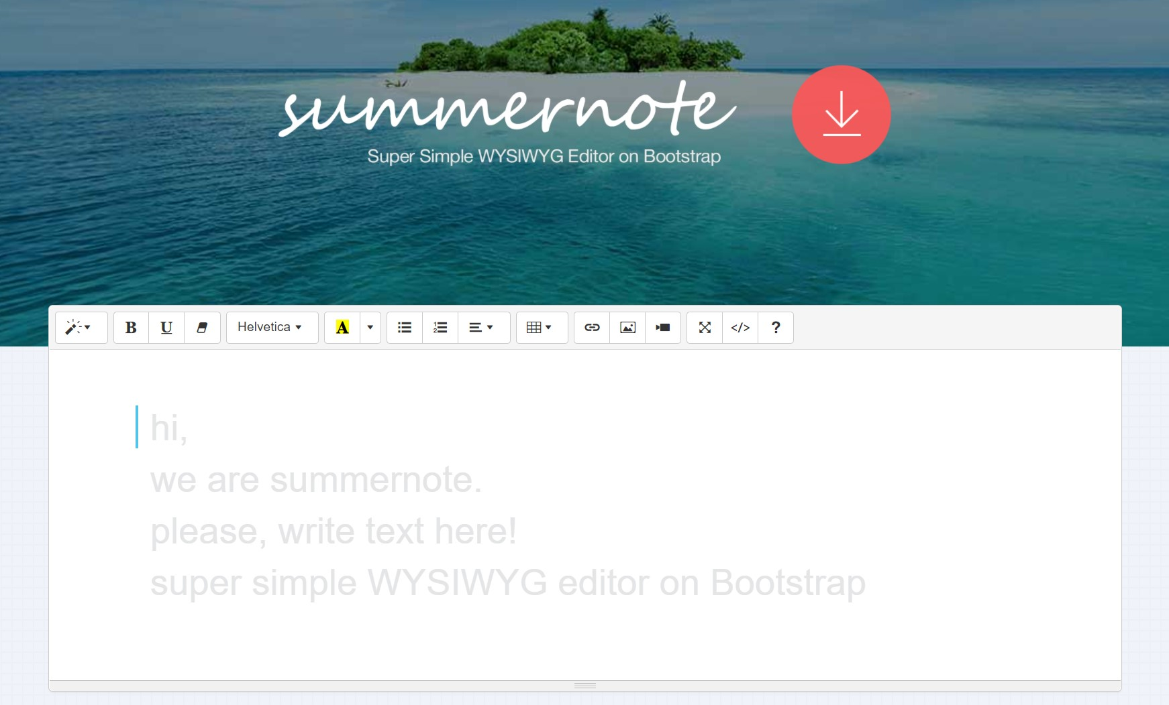
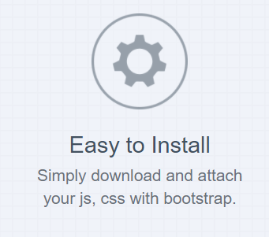
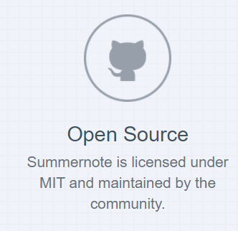
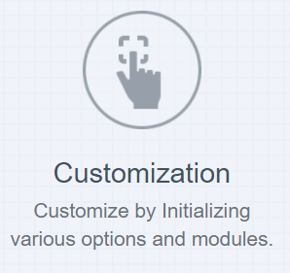

WYSIWYG Editor
Summernote is a JavaScript library that helps you create WYSIWYG editors online.

Slide 15


FPDF is a PHP class which allows to generate PDF files with pure PHP, that is to say without using the PDFlib library.
How We Generate PDF
Main features
Choice of measure unit, page format and margins
Automatic line break and text justification
Image support (JPEG, PNG and GIF)
Colors
Links
Page compression

Slide 16



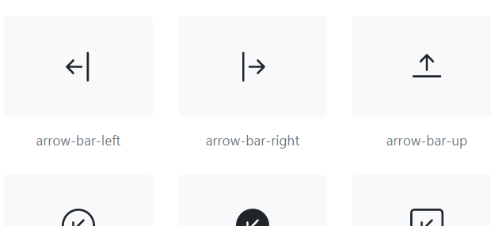


Bootstrap Framework HTML & CSS Templates Responsive Website
CSS FRAMEWORK & ICONS
Font Awesome icon toolkit

Slide 17

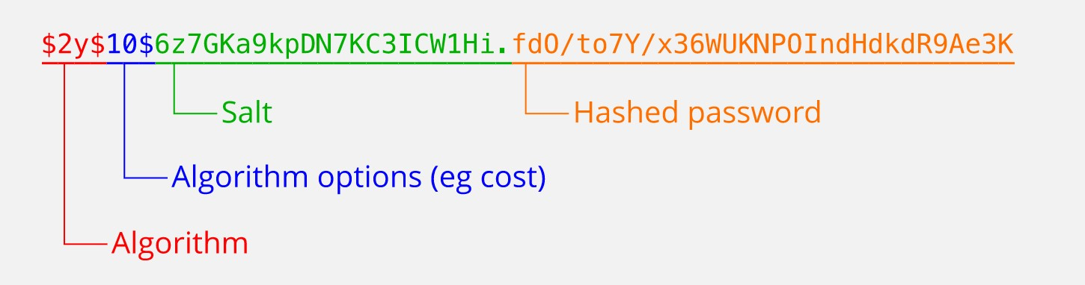
Encryption
Huge Number of Hash Database
1,154,870,188,082
Message-Digest Algorithm
Produce 128-bit hashed value
Not Reversible Function

Slide 18

Online Meetings
Schedule a Meeting
Use Google
Meet
Use Zoom
Google Meet is a video-communication-service developed by Google.
Zoom Video Communications, Inc. is an American communications technology company, It provides video telephony

Slide 19



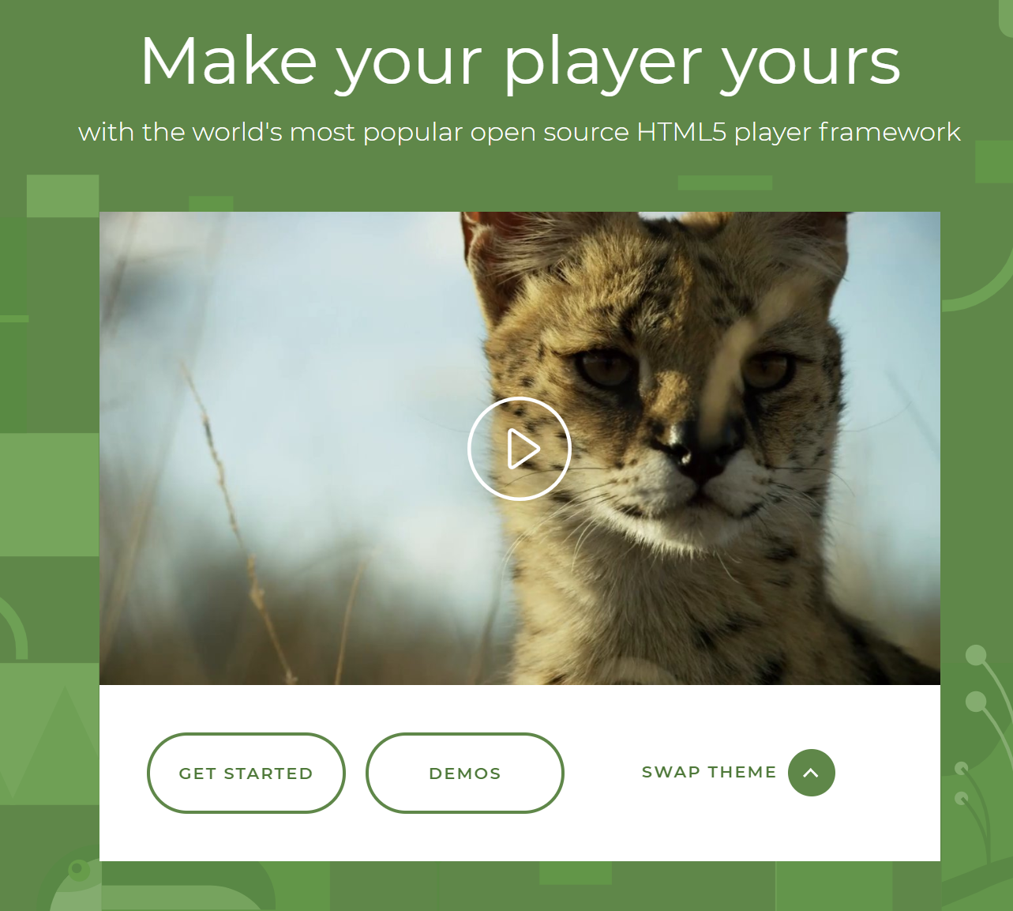
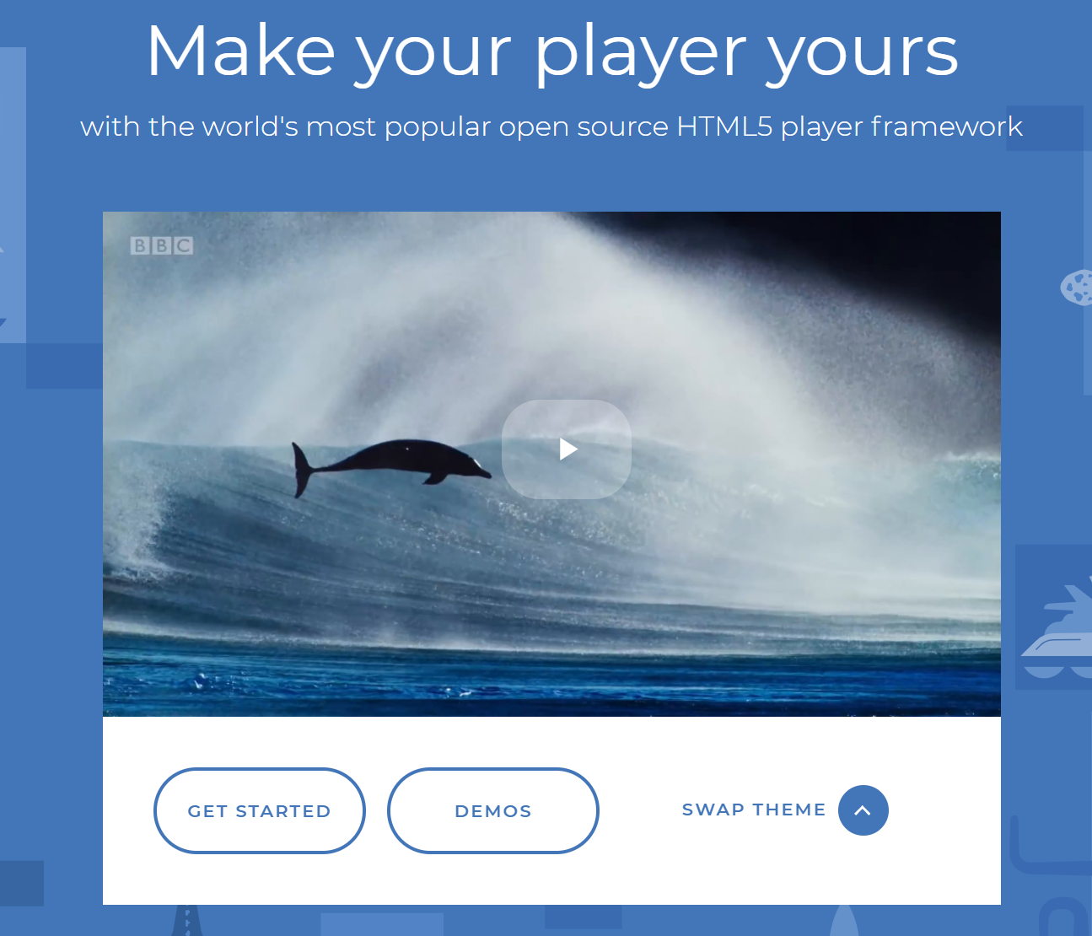
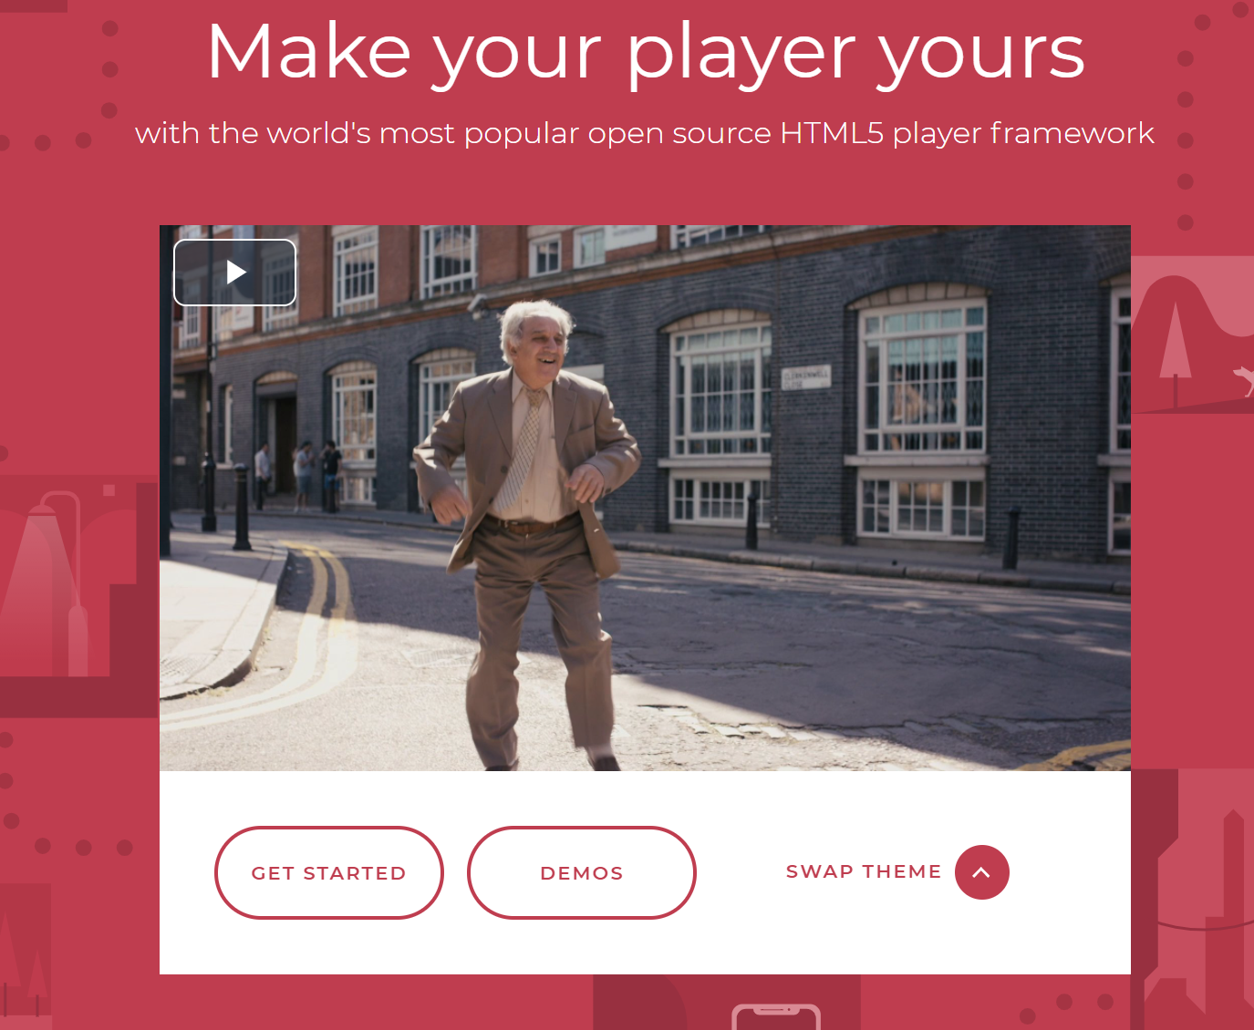
Media Player
Supports HTML5 video and streaming
Easy Plugins install Chromecast, IMA
Reliable and Consistent
Play Any format Videos

Slide 20

Conclusion
Build for hassle free Exam System via online
Leading University students and teachers are main user
User friendly interface
Can be monitored the Website easily

Slide 21
THE END

